Slide 1


A Project on
Gas Cylinder Leakage Detection , Weight Checking & Automatic Booking over IoT
Student Roll No Name Of The Student
208R5A0501
198R1A0540
198R1A0524
198R1A0537
G.Sreenivasulu
Y.Siva Kumari
P.Hima Bindu
U.Laxman Sai Kiran
Under the esteemed guidance of
Dr. G. Rama Subba Reddy M.E.Ph.D
Professor & Head
Department of Computer Science & Engineering
SAI RAJESWARI INSTITUTE OF TECHNOLOGY
Lingapuram (V), Proddatur, Y S R District -- 516362, A.P.

Slide 2
Abstract
Now a days we all are very busy in our daily life and it is difficult to know the status of LPG gas cylinders. If LPG is going to finish without informing us it can create very difficult conditions for cooking etc. This project is used to continuously monitor the weight of the LPG gas cylinder. Many times we observe that in our home whenever an LPG gas cylinder is empty, then we give a request for a new cylinder at the office of the LPG gas provider. Many times it happens that because of a shortage of LPG gas cylinders, there is a delay in providing gas cylinders. To overcome this drawback we introduced this system.
In this project, we proposed an LPG Gas Weight and Leakage Detection System Using IoT. This is useful in various applications in homes and hotels. Many times it happens because of the rush or due to a shortage of cylinders. The main reason behind this is the delay in informing the gas provider at the last moment when the gas cylinder is empty. Our Proposed design can help us to avoid such kinds of problems in our daily life. Our design is based on a microcontroller, it can track LPG emptiness all the time if LPG is very close to finish or at an empty level then it can alert by sending an SMS to the owner & it can also transfer message to LPG Agency for ordering the LPG cylinder. It can detect LPG leakage & start alarms.

Slide 3
Existing System
In the existing system, if the LPG gas is going to leak, then the MQ-6 gas sensor will sense the LPG and butane gas concentrates in the air either at home or in industry, it will give a HIGH pulse on its DO pin and Arduino constantly reads its DO pin.
When Arduino receives a HIGH pulse from the LPG Gas sensor module it displays that LPG Gas Leakage Alert message on a 16x2 LCD and stimulates a buzzer which beeps again until the gas detector module doesn’t recognize the gas in the environment.
Arduino device will produce the buzzer sound based on the time duration by given instructions in code. When Arduino gets a LOW pulse from the LPG Gas detector module, then LCD will show that No LPG Gas Leakage alert message.
Arduino manages the complete process of this system like reading the LPG Gas sensor module output, sending a message to LCD, and stimulating the buzzer. We can set the sensitivity of this sensor module by an inbuilt potentiometer located on it.

Slide 4
Advantages
To prevent gas leakages and gas leakage accidents
Having costs not too high
An alert system is there for the user through the buzzer.
Low power consumption.
Simple Architecture
Helpful for every chef

Slide 5
Disadvantages
There is no automatic booking system. The user should book the gas manually.
The user is not able to know how much gas remains.

Slide 6
Proposed System
In this proposed system, the gas leakage is detected by MQ 6 sensor which is interfaced with the microcontroller, when the gas leakage is detected through the MQ 6 sensor the motor gets on and the lights get off with a buzzer alarm and displays an alert message in LCD display, at the same time the notification will be sent to the user through mobile which is connected via Wi-Fi Further, working of this proposed system is as below
Load cell which is also known as a pressure sensor is used to detect the weight of the gas and the result will be displayed through an LCD display
GSM modem is capable of sending and receiving messages and the result will be displayed through LCD display.
If the weight of the cylinder is below the threshold level, the booking confirmation message will be sent to the user through mobile
Message will be sent from the GSM module to the LPG agency and gets a return notification of when the LPG is delivered.

Slide 7
Advantages
This system will be sent an alert notification to the user that the gas is going to be leaking.
The Buzzer alert system is present for the user.
Automatically Cylinder Booking system when the gas is completed.
Mobile interaction is present.
It sends a notification to the user after booking the Gas Cylinder.
The user can able to receive the notification that gas has just been booked.
Cost-effective.

Slide 8
Disadvantages
No automatic online payment.
Power Consumption is little bit high.

Slide 9
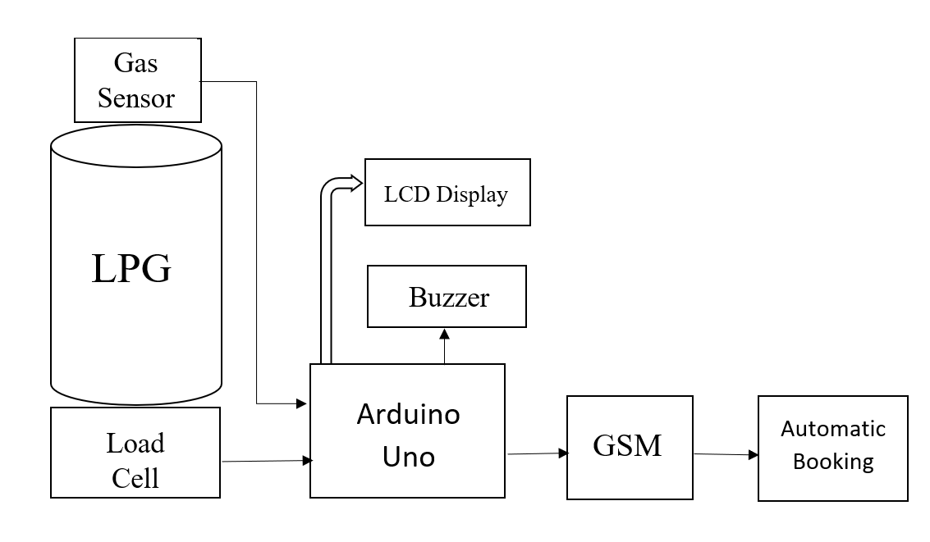
Architecture

Slide 10
Modules
Arduino Module
Sensor Module
Display Module
GSM Module

Slide 11
Description of Modules
Arduino module: Arduino Uno is a microcontroller board based on an 8-bit ATmega328P microcontroller. This is the main part of this project which takes total responsibility to control the device components which are connected to it.
Sensor module: The sensor module consists of a Gas sensor and Load cell. A gas sensor is used for detecting gas leakage and the load cell senses the gas weight and gives results in LCD display.
Display Module: LCD display shows the actual weight of the gas, various status messages like “Sending SMS”, “SMS sent” “Gas has reached 20% value” or “Gas has reached 5% value”. so that person can know through these messages.
GSM Module: A GSM modem or GSM module is a device that maneuvers GSM mobile telephone mechanization to provide a cellular data link to a meshwork.

Slide 12
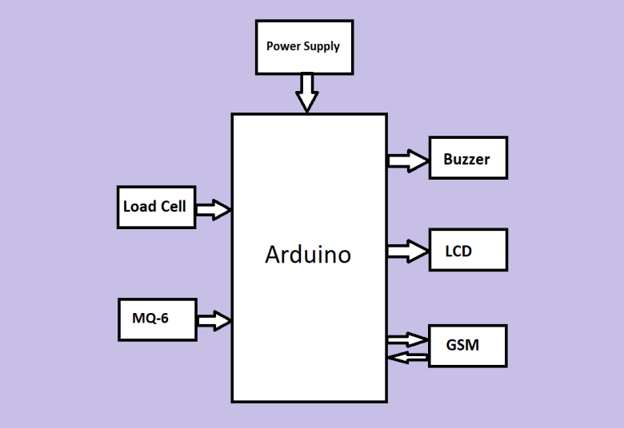
Block Diagram

Slide 13
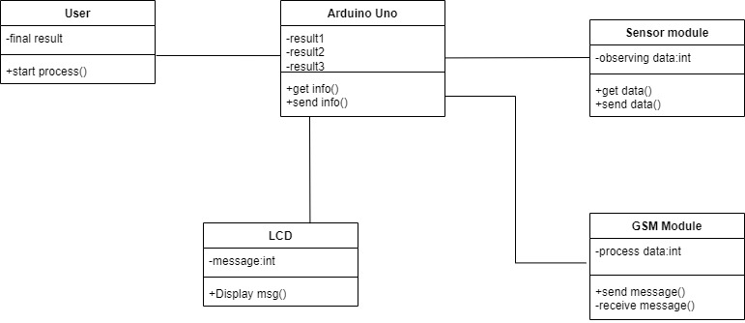
.
UML Diagrams
Class Diagram

Slide 14
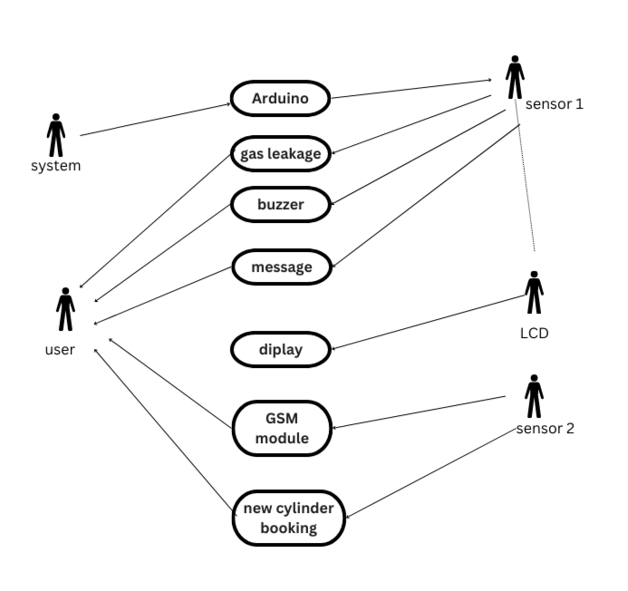
Use Case Diagram

Slide 15
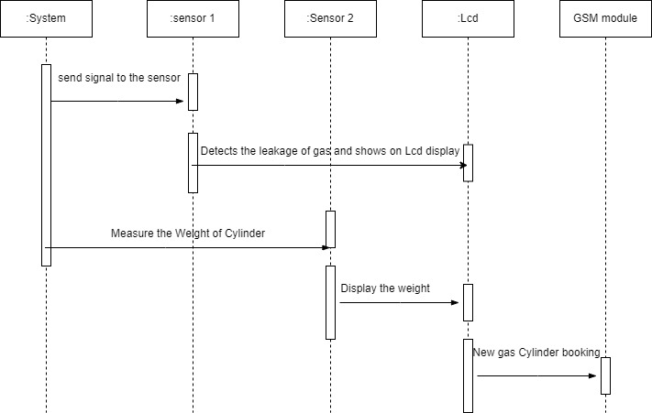
Sequence Diagram

Slide 16
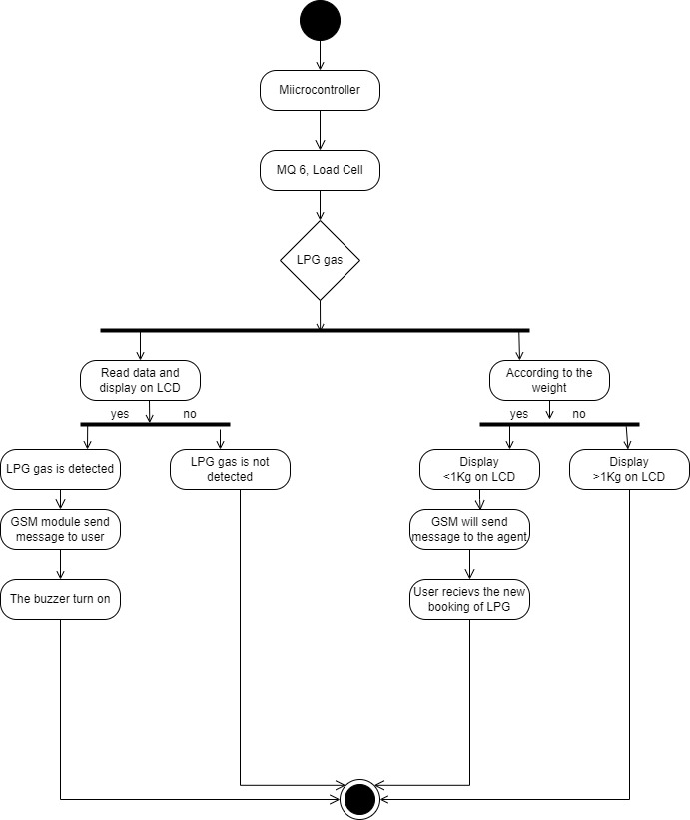
State Diagram

Slide 17
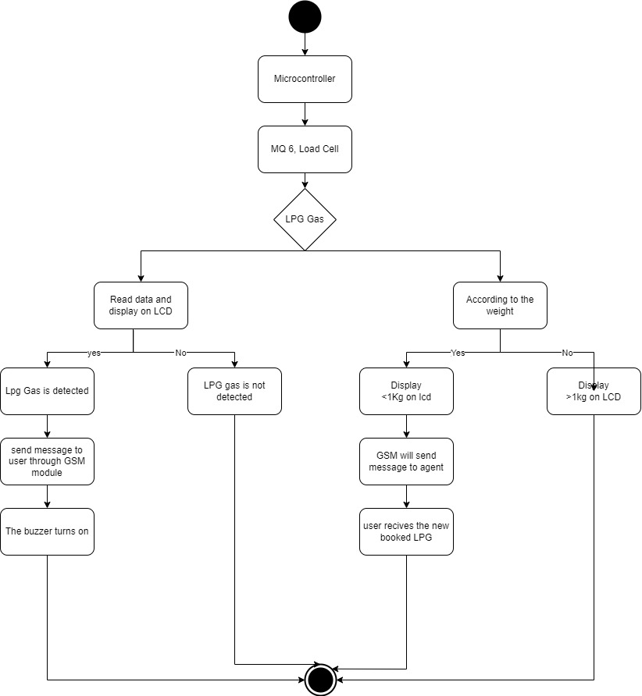
Activity Diagram

Slide 18
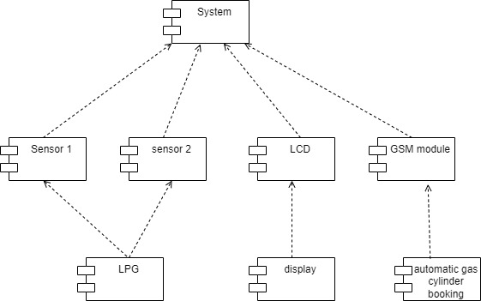
Component Diagram

Slide 19
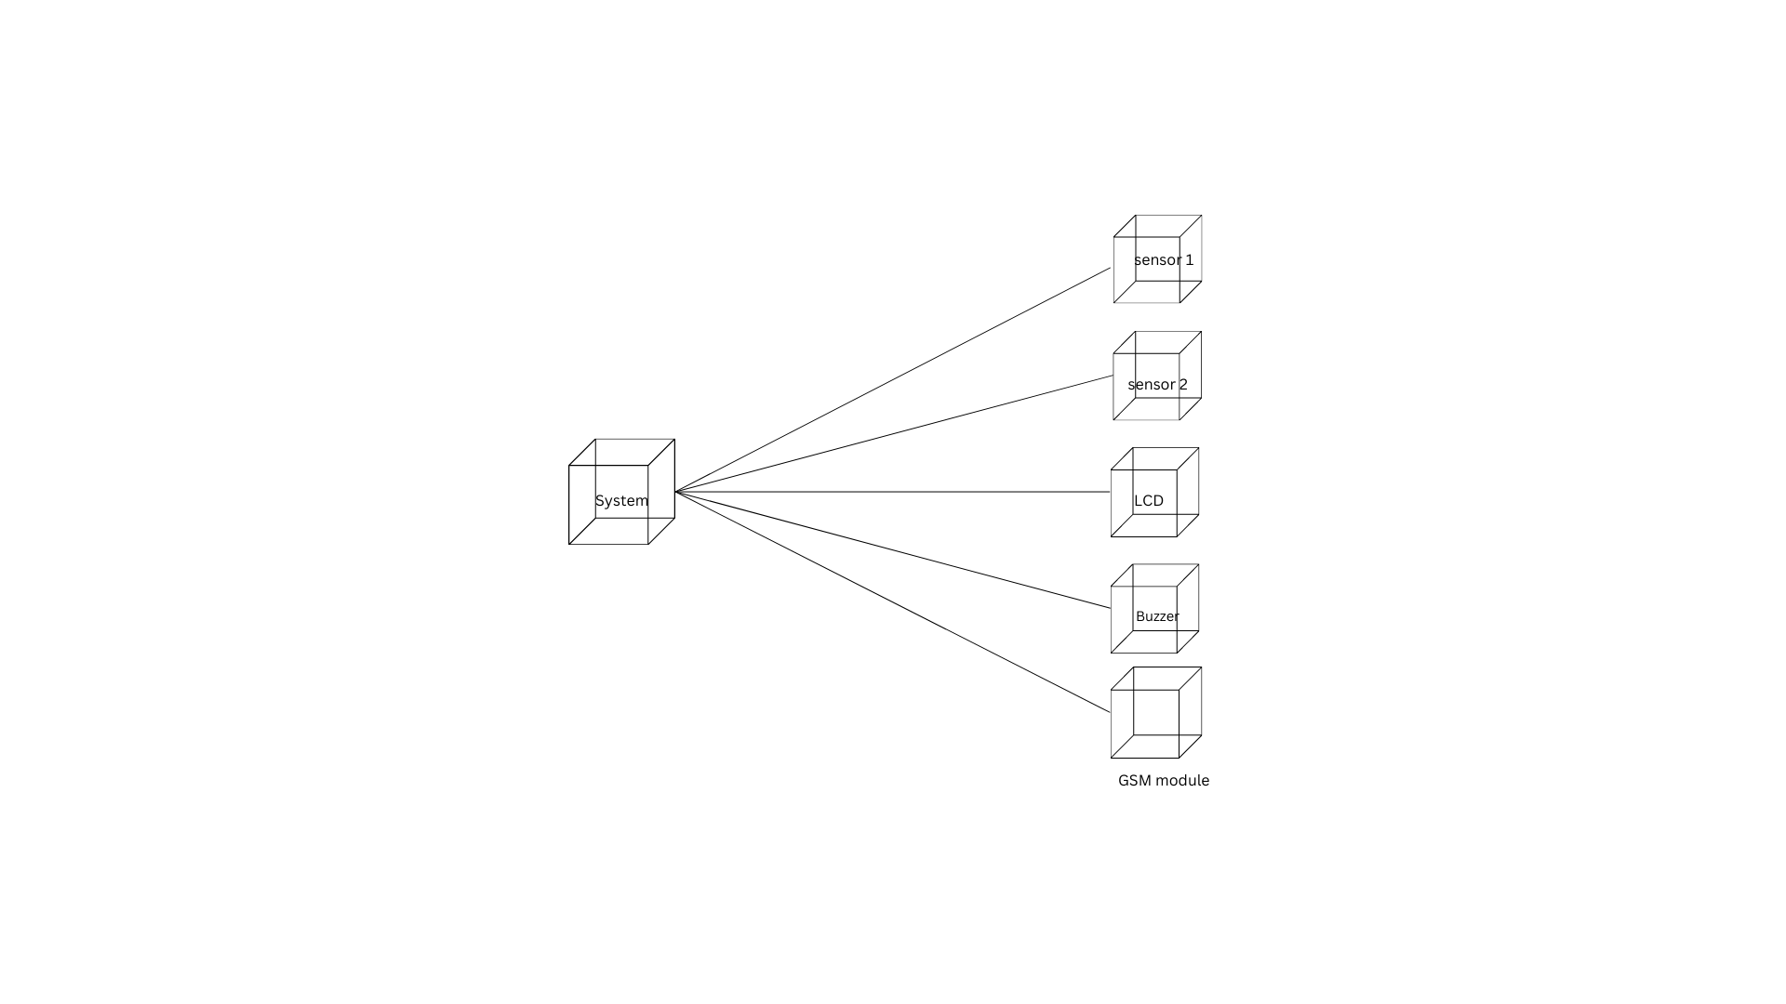
Deployment Diagram

Slide 20
Hardware Requirements
Arduino UNO
Load cell
LCD
Buzzer
GSM Module
MQ-6 gas sensor
Battery
Connecting wires

Slide 21
Software Requirements
Programming Language - C++
Operating System - Windows 7 or Above
Arduino IDE - Version (1.8.2)

Slide 22
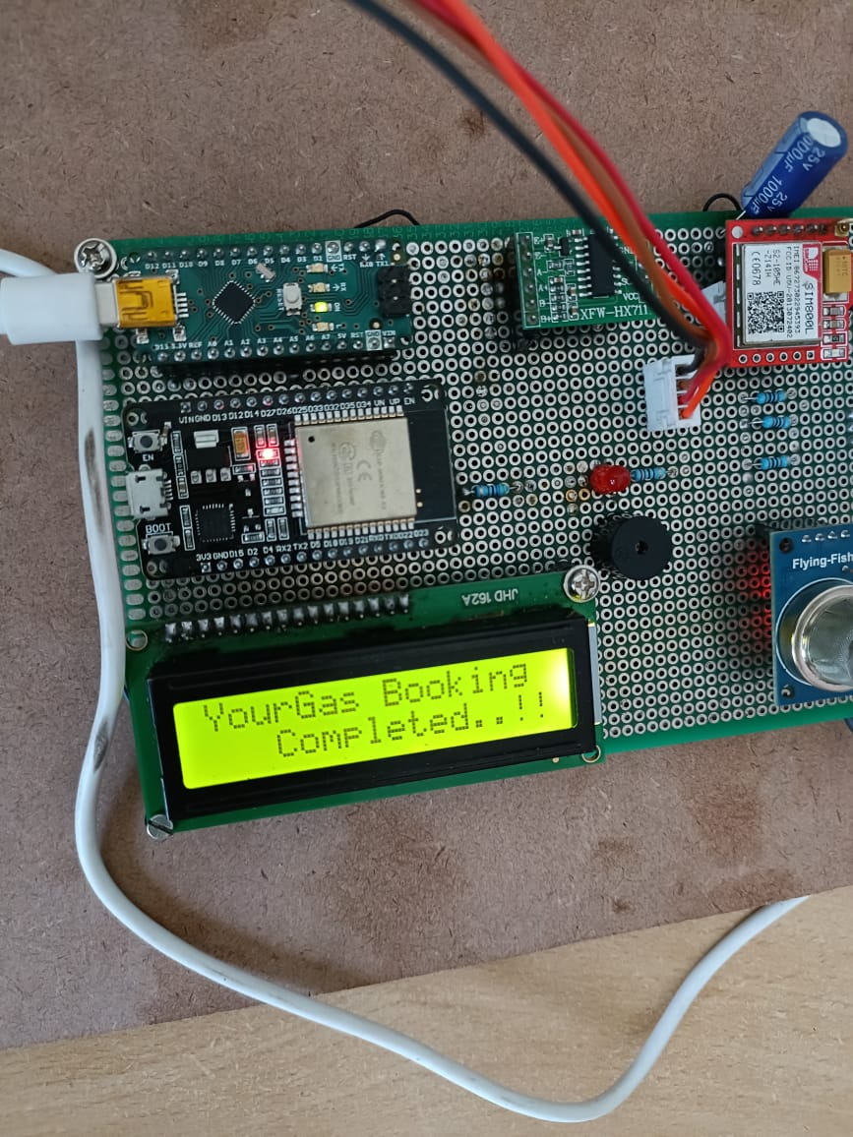
Outputs

Slide 23
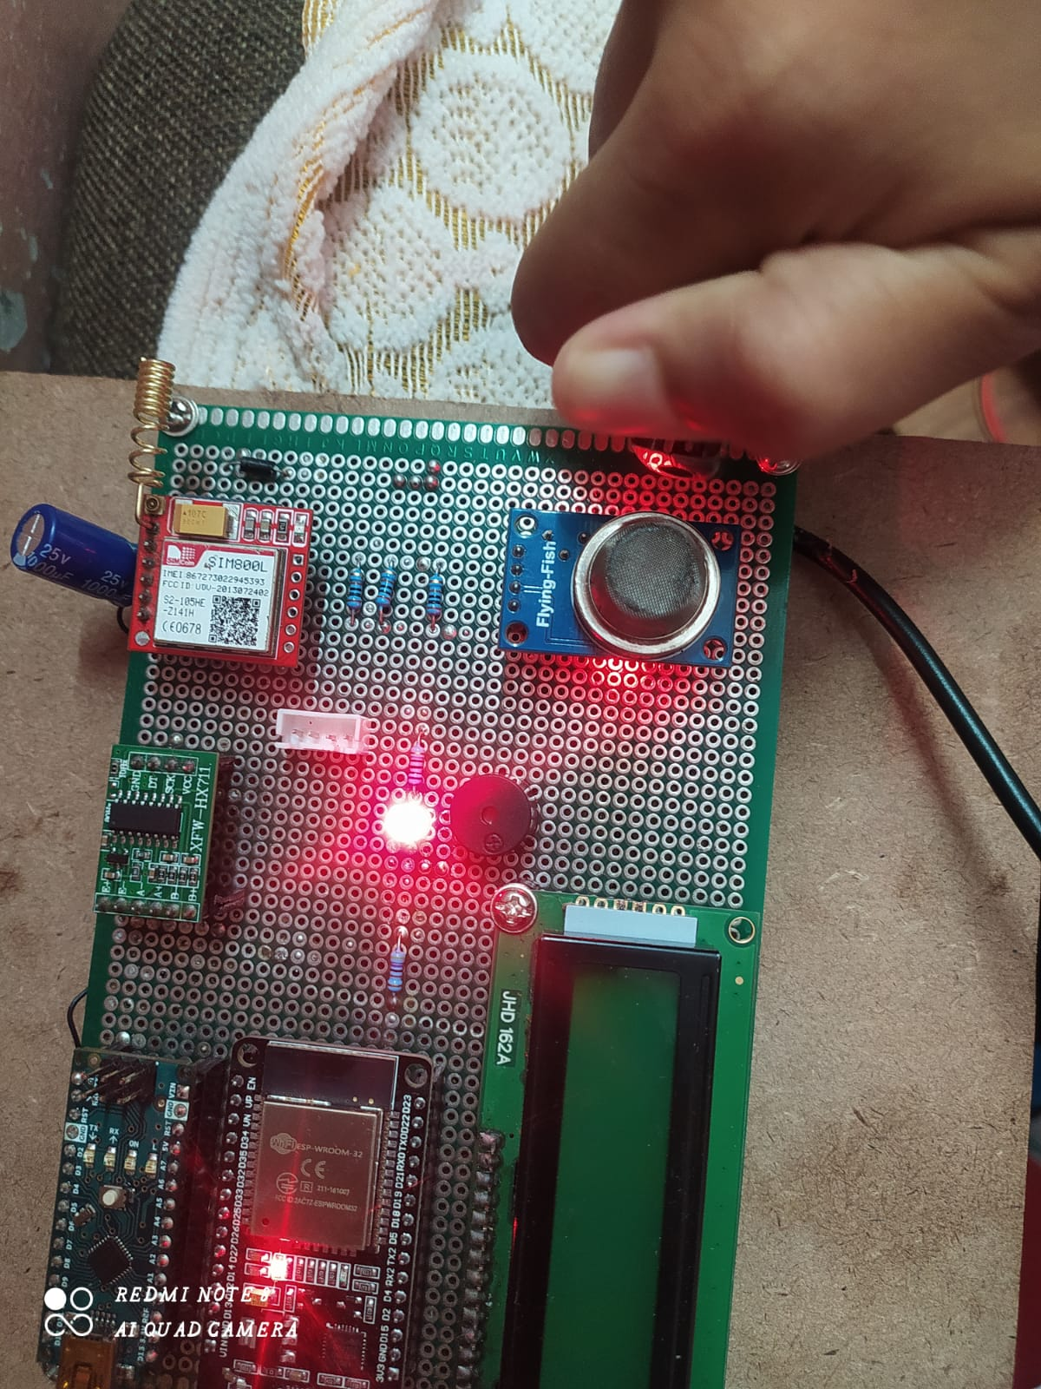
Outputs
When LPG Gas is going to be leaking
Buzzer will produce beep sounds

Slide 24
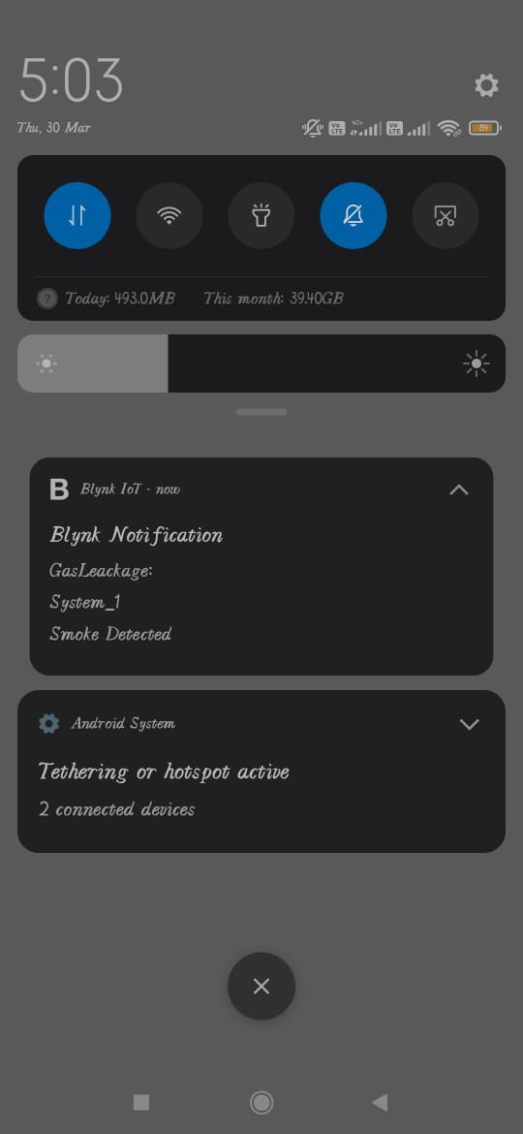
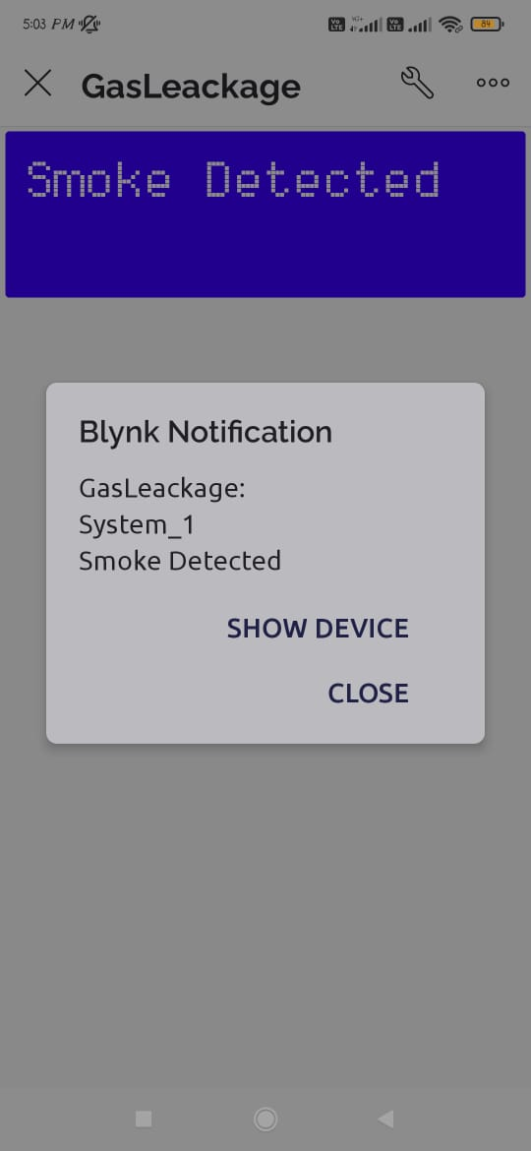
Outputs
Notification will sent to mobile

Slide 25
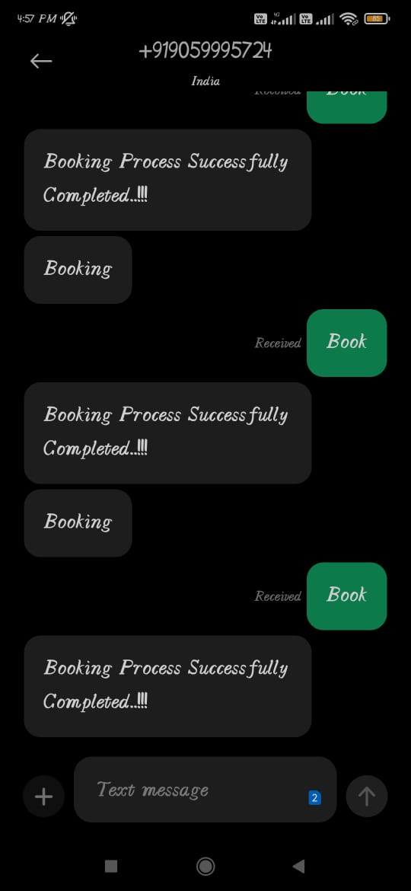
Outputs

Slide 26
Conclusion
The major motive here is to bring forth safety to the users of LPG (Liquefied Petroleum Gas) in various sectors like cooking, automobiles, industries, etc. A budget-friendly gas leakage detection system was put forward, mapped out, and successfully executed in this paper. It uses an MQ-6 sensor and load cell to monitor the LPG being used completely to prevent accidents caused by carelessness or misuse of LPG. In addition to gas leakage detection, this system gives an entirely mechanized approach to gas booking. The cost incriminated in developing the system is outstandingly low and is much less than the cost of gas detectors economically obtainable in the market.

Slide 27


